Slide 1
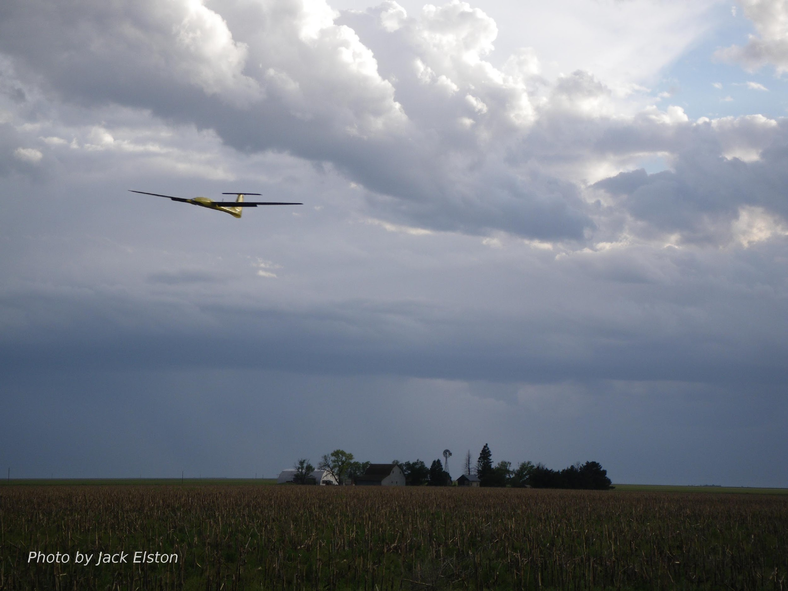
Chapter 12
Path Planning

Slide 2
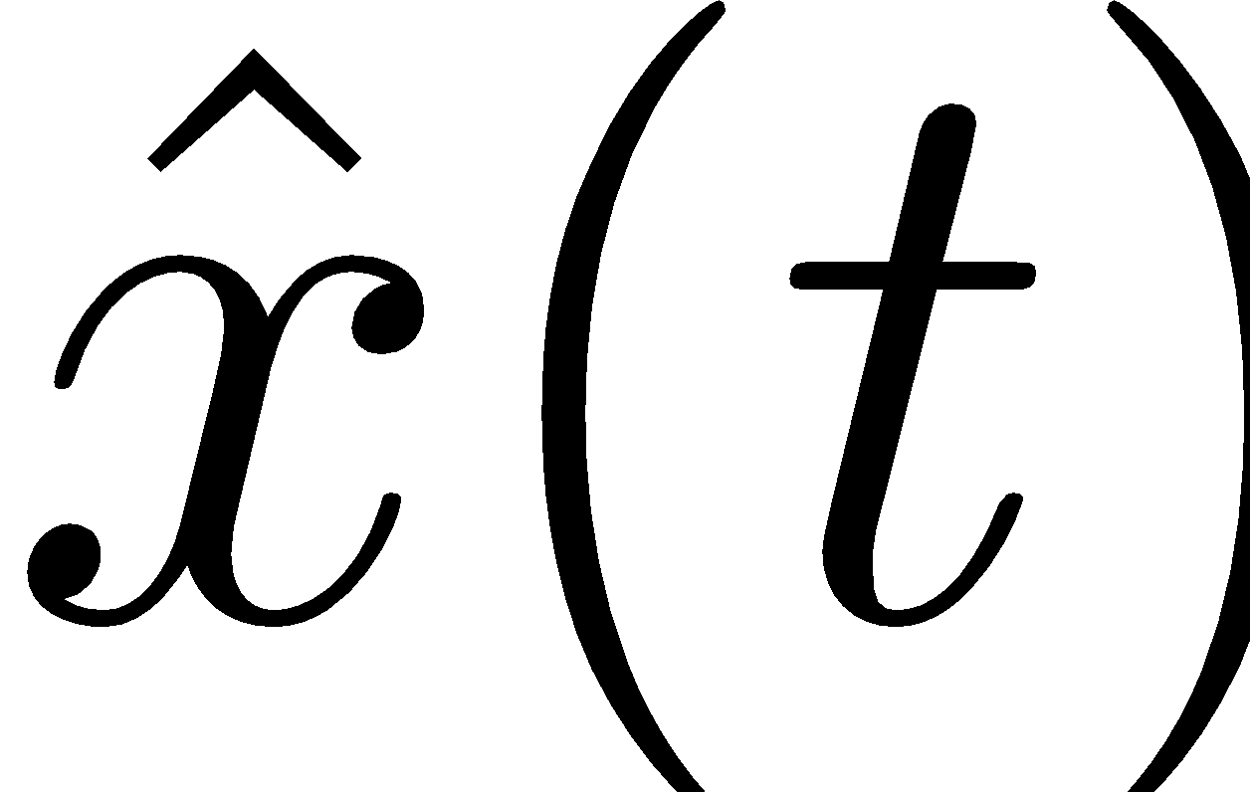
Control Architecture
destination, obstacles
map
path planner
waypoints
status
path manager
path definition
tracking error
path following
airspeed, altitude,
heading,
commands
position error
autopilot
servo commands
state estimator
unmanned aircraft
wind
on-board sensors

Slide 3
Path Planning Approaches
Deliberative
Based on global world knowledge
Requires a good map of terrain, obstacles, etc.
Can be too computationally intense for dynamic environments
Usually executed before the mission
Reactive
Based on what sensors detect on immediate horizon
Can respond to dynamic environments
Not usually used for entire mission

Slide 4
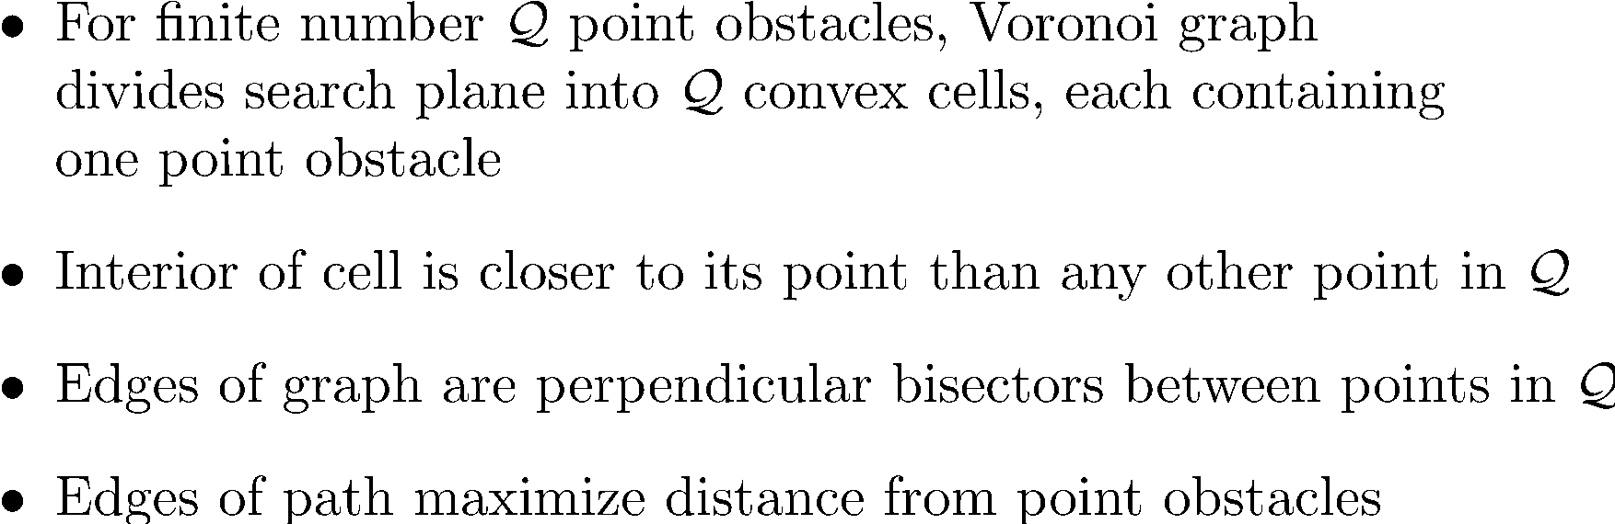
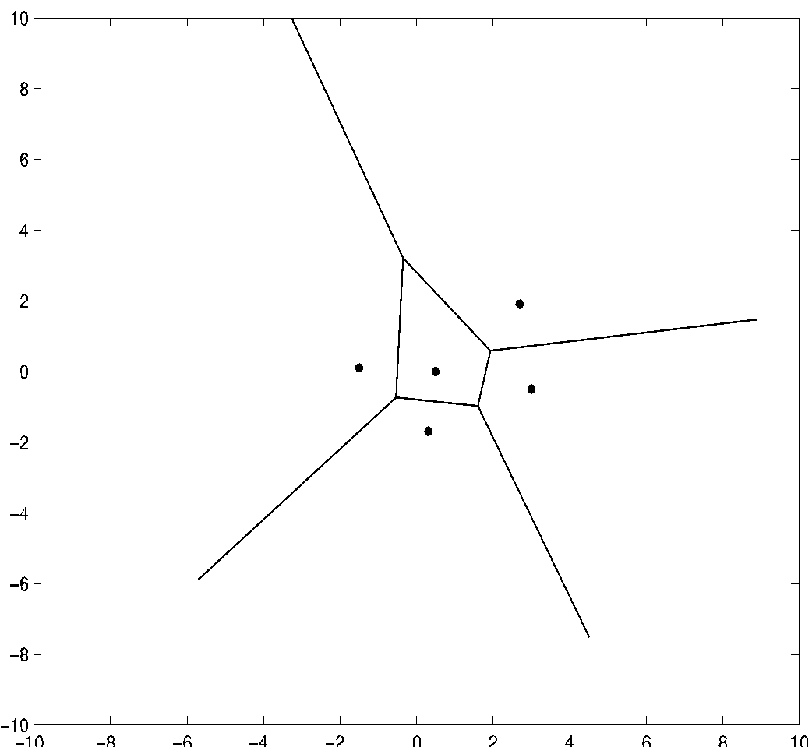
Voronoi Graphs
Notes:
\begin{itemize}
\item For finite number $\mathcal{Q}$ point obstacles, Voronoi graph \\ divides search plane into $\mathcal{Q}$ convex cells, each containing \\ one point obstacle
\item Interior of cell is closer to its point than any other point in $\mathcal{Q}$
\item Edges of graph are perpendicular bisectors between points in $\mathcal{Q}$
\item Edges of path maximize distance from point obstacles
\end{itemize}

Slide 5
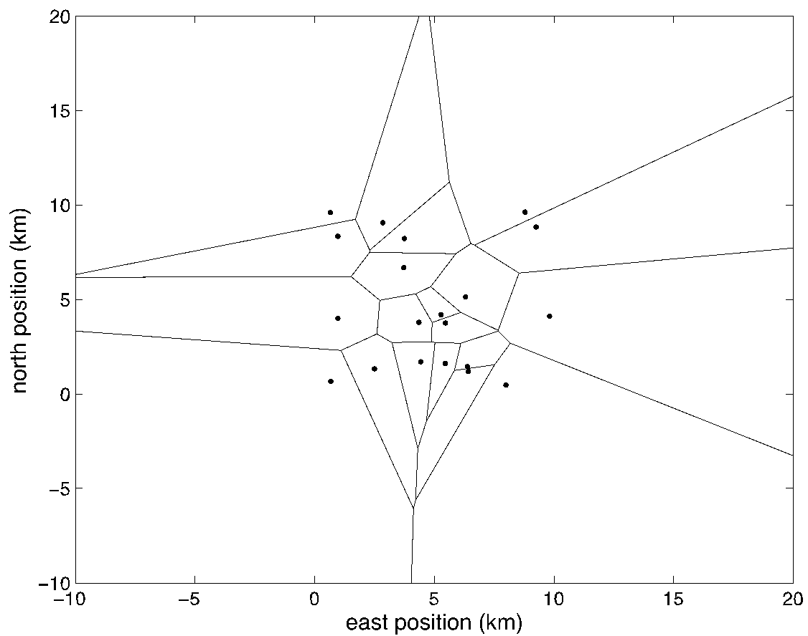
Voronoi Graph Example
Graph generated using voronoi command in Matlab
20 point obstacles
Start and end points of path not shown

Slide 6
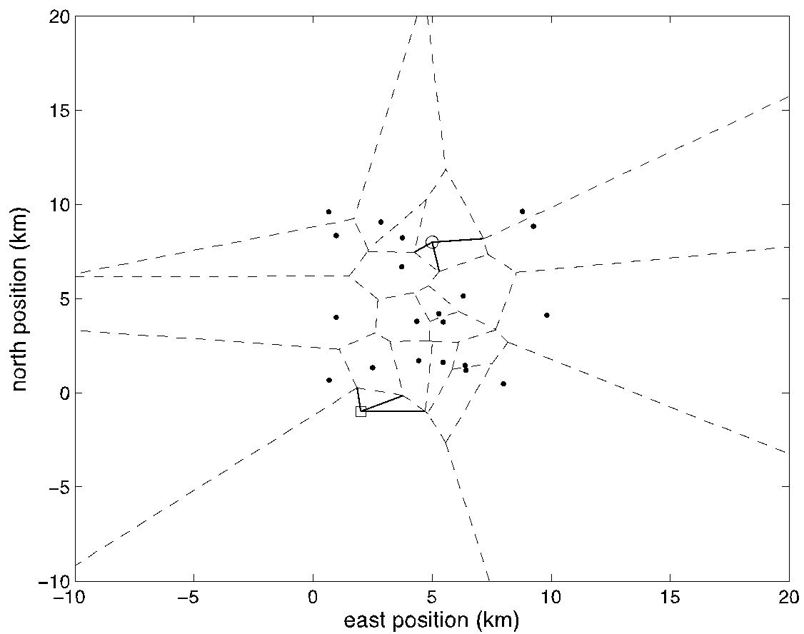
Voronoi Graph Example
Add start and end points to graph
Find 3 closest graph nodes to start and end points
Add graph edges to start and end points
Search graph to find “best” path
Must define “best”
Shortest?
Furthest from obstacles?

Slide 7
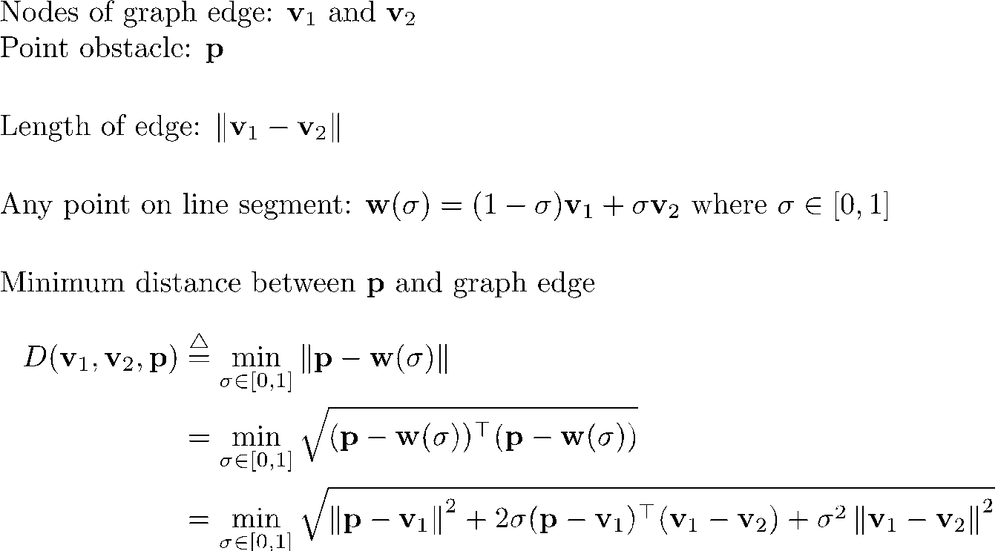
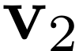


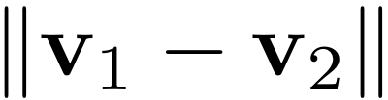

Path Cost Calculation
Notes:
\noindent
Nodes of graph edge: $\mathbf{v}_1$ and $\mathbf{v}_2$ \\
Point obstacle: $\mathbf{p}$
\vspace{0.5cm}
\noindent Length of edge: $\norm{\mathbf{v}_1-\mathbf{v}_2}$
\vspace{0.5cm}
\noindent Any point on line segment:
$\mathbf{w}(\sigma) = (1-\sigma)\mathbf{v}_1 + \sigma \mathbf{v}_2$ where $\sigma\in[0,1]$
\vspace{0.5cm}
\noindent
Minimum distance between
$\mathbf{p}$ and graph edge
\begin{align*}
D(\mathbf{v}_1,\mathbf{v}_2,\mathbf{p}) &\defeq
\min_{\sigma\in[0,1]}\norm{\mathbf{p}-\mathbf{w}(\sigma)} \\
&=\min_{\sigma\in[0,1]} \sqrt{ (\mathbf{p}-\mathbf{w}(\sigma))^{\top}(\mathbf{p}-\mathbf{w}(\sigma)) } \\
&=\min_{\sigma\in[0,1]} \sqrt{
\norm{\mathbf{p}-\mathbf{v}_1}^2
+ 2\sigma(\mathbf{p}-\mathbf{v}_1)^{\top}(\mathbf{v}_1-\mathbf{v}_2) +
\sigma^2\norm{\mathbf{v}_1-\mathbf{v}_2}^2}.
\end{align*}

Slide 8
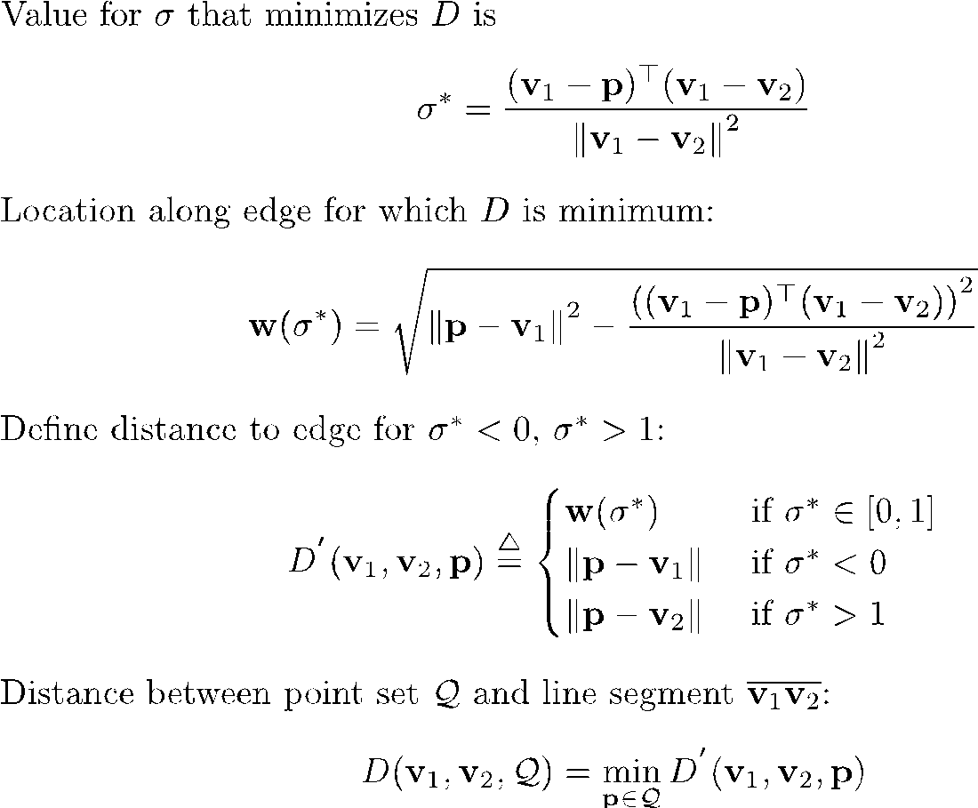
Path Cost Calculation
Notes:
\noindent Value for $\sigma$ that minimizes $D$ is
\[
\sigma^{\ast} = \frac{(\mathbf{v}_1-\mathbf{p})^{\top}
(\mathbf{v}_1-\mathbf{v}_2)}{\norm{\mathbf{v}_1-\mathbf{v}_2}^2}
\]
\noindent Location along edge for which $D$ is minimum:
\[
\mathbf{w}(\sigma^{\ast}) = \sqrt{\norm{\mathbf{p}-\mathbf{v}_1}^2 -
\frac{\left((\mathbf{v}_1-\mathbf{p})^{\top}(\mathbf{v}_1-\mathbf{v}_2)\right)^2}{\norm{\mathbf{v}_1-\mathbf{v}_2}^2}}
\]
\noindent Define distance to edge for $\sigma^\ast<0$, $\sigma^\ast>1$:
\[
D^{'}(\mathbf{v}_1,\mathbf{v}_2,\mathbf{p}) \defeq
\begin{cases} %
\mathbf{w}(\sigma^{\ast}) & \text{~if~} \sigma^{\ast}\in[0,1] \\
\norm{\mathbf{p}-\mathbf{v}_1} & \text{~if~} \sigma^{\ast}<0 \\
\norm{\mathbf{p}-\mathbf{v}_2} & \text{~if~} \sigma^{\ast}>1
\end{cases}
\]
\noindent Distance between point set $\mathcal{Q}$ and line segment $\overline{\mathbf{v}_1\mathbf{v}_2}$:
\[
D(\mathbf{v}_1,\mathbf{v}_2,\mathcal{Q}) = \min_{\mathbf{p}\in\mathcal{Q}} D^{'}(\mathbf{v}_1,\mathbf{v}_2,\mathbf{p})
\]

Slide 9
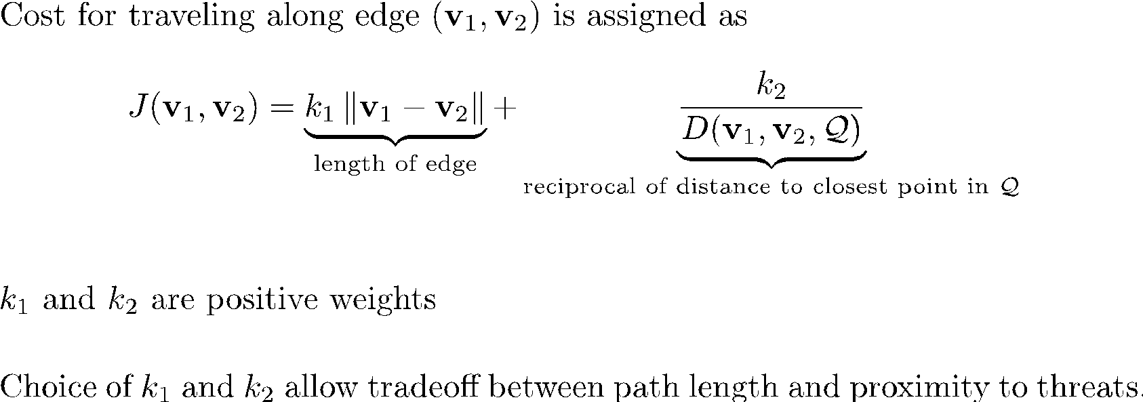
Path Cost Calculation
Notes:
\noindent Cost for traveling along edge $(\mathbf{v}_1,\mathbf{v}_2)$ is assigned as
\begin{equation*}
J(\mathbf{v}_1,\mathbf{v}_2) = \underbrace{k_1 \norm{\mathbf{v}_1-\mathbf{v}_2}}_\text{length of edge} +
\underbrace{\frac{k_2}{D(\mathbf{v}_1,\mathbf{v}_2,\mathcal{Q})}}_\text{reciprocal of distance to closest point in $\mathcal{Q}$}
\end{equation*}
\vspace{0.5cm}
\noindent $k_1$ and $k_2$ are positive weights
\vspace{0.5cm}
\noindent Choice of $k_1$ and $k_2$ allow tradeoff between path length and proximity to threats.

Slide 10
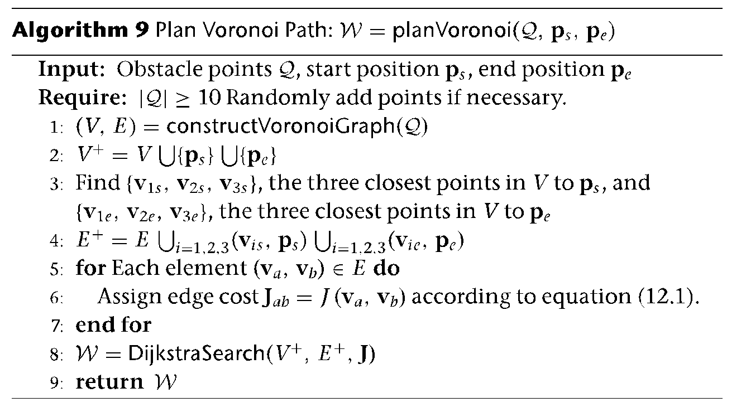
Voronoi Path Planning Algorithm
Dijkstra’s algorithm is used to search the graph
Voronoi graph and Dijkstra’s algorithm code are commonly available
Matlab:
Voronoi -> voronoi
Dijkstra -> shortestpath

Slide 11
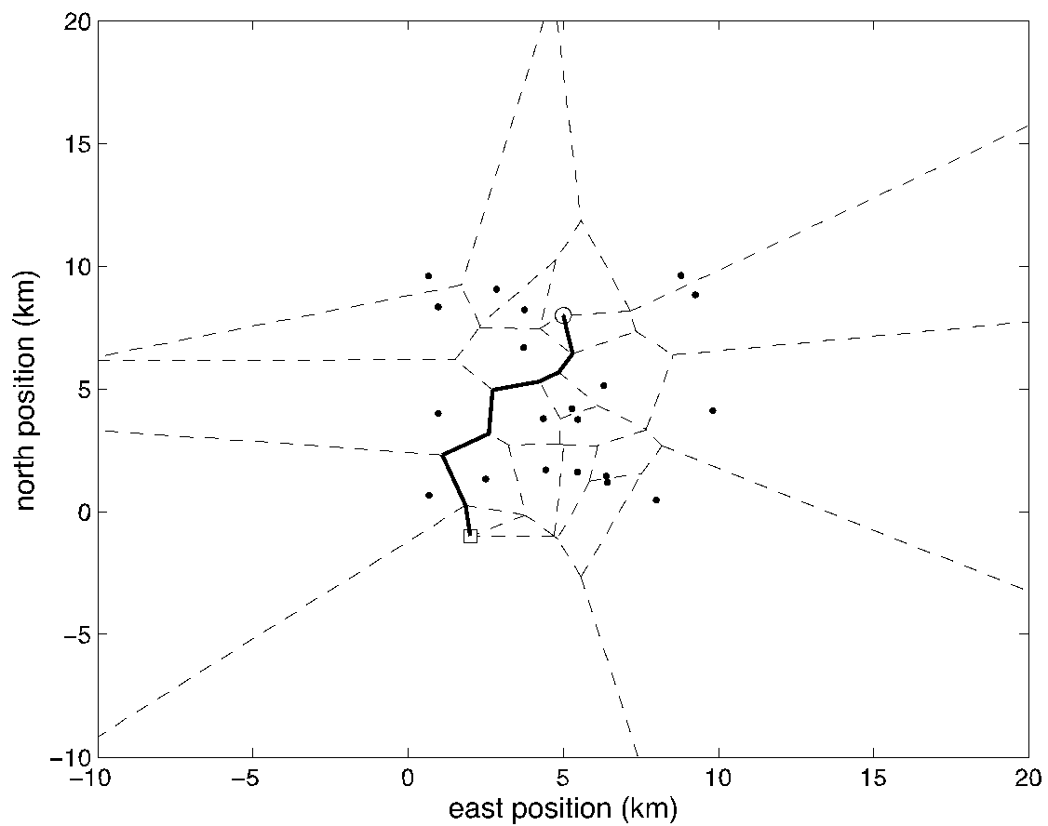
Voronoi Path Planning Result

Slide 12
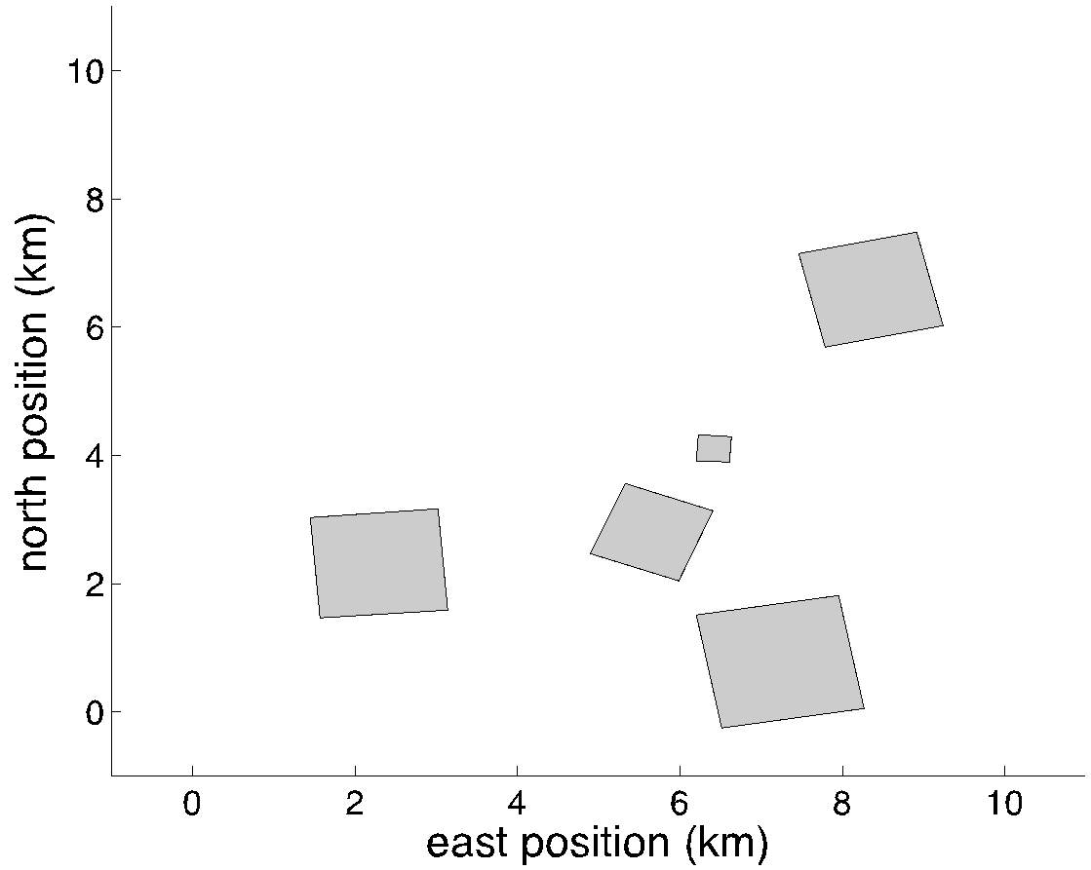
Voronoi Path Planning – Non-point Obstacles
How do we handle solid obstacles?
Point obstacles at center of spatial obstacles won’t provide safe path options around obstacles

Slide 13
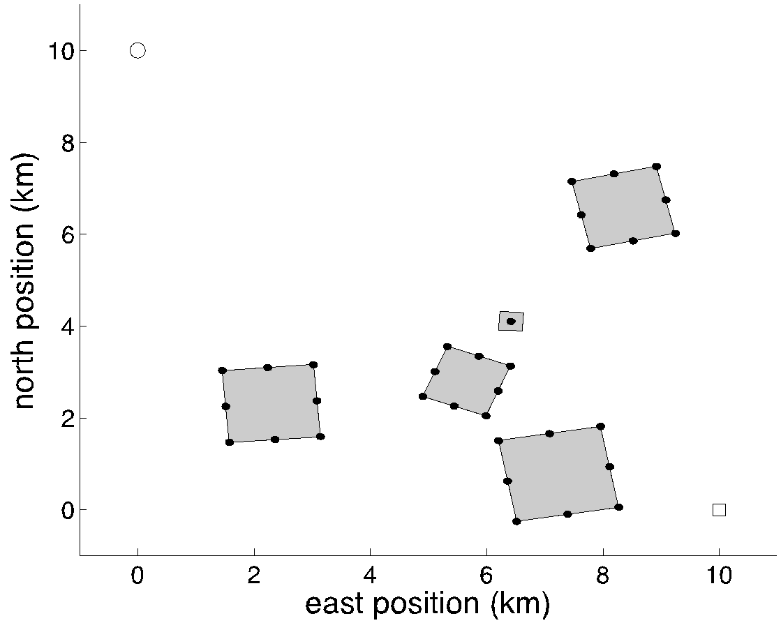
Non-point Obstacles – Step 1
Insert points around perimeter of obstacles

Slide 14
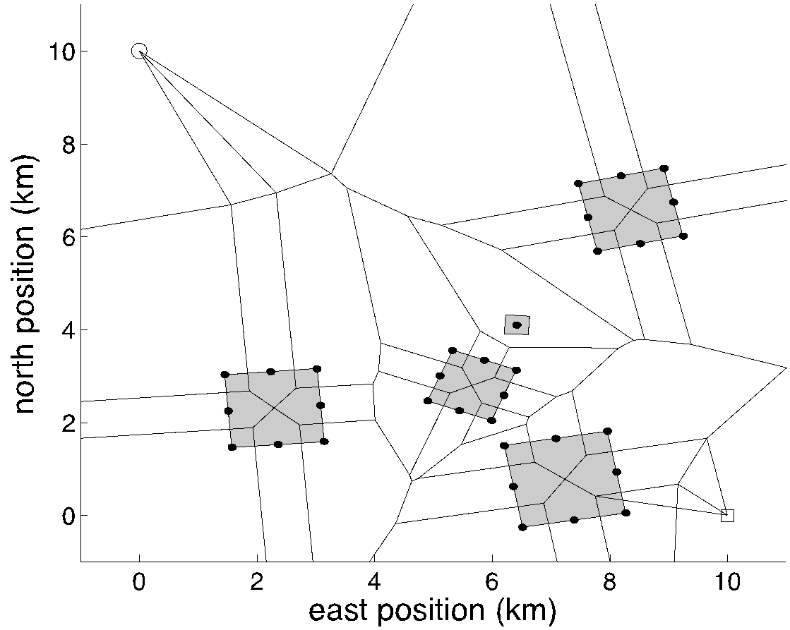
Non-point Obstacles – Step 2
Construct Voronoi graph
Note infeasible path edges inside obstacles

Slide 15
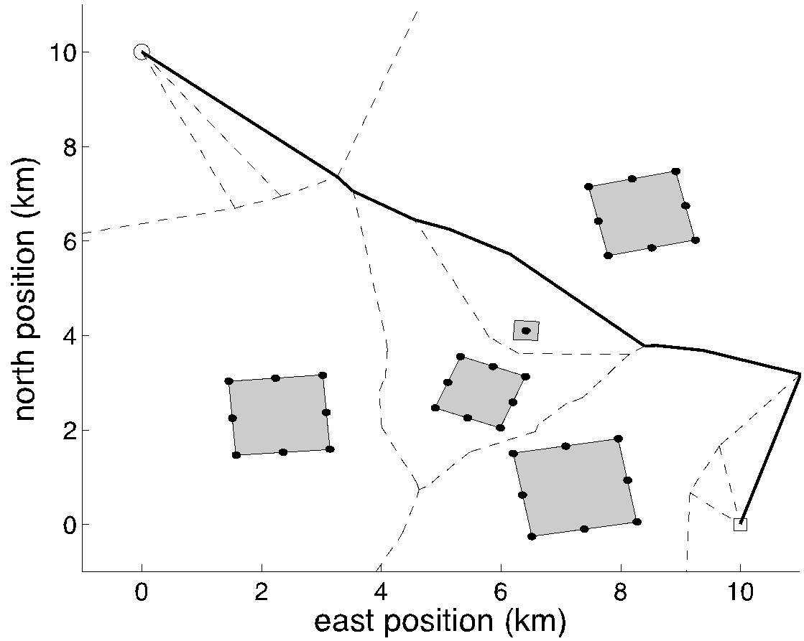
Non-point Obstacles – Step 3
Remove infeasible path edges from graph
Search graph for best path

Slide 16







Rapidly Exploring Random Trees (RRT)
Exploration algorithm that randomly, but uniformly explores search space
Can accommodate vehicles with complicated, nonlinear dynamics
Obstacles represented in a terrain map
Map can be queried to detect possible collisions
RRTs can be used to generate a single feasible path or a tree with many feasible paths that can be searched to determine the best one
If algorithm runs long enough, the optimal path through the terrain will be found

Slide 17





RRT Tree Structure
RRT algorithm is implemented using tree data structure
Tree is special case of directed graph
Edges are directed from child node to parent
Every node has one parent, except root
Nodes represent physical states or configurations
Edges represent feasible paths between states
Each edge has cost associated traversing feasible path between states

Slide 18
RRT Algorithm
Algorithm initialized
start node
end node
terrain/obstacle map

Slide 19
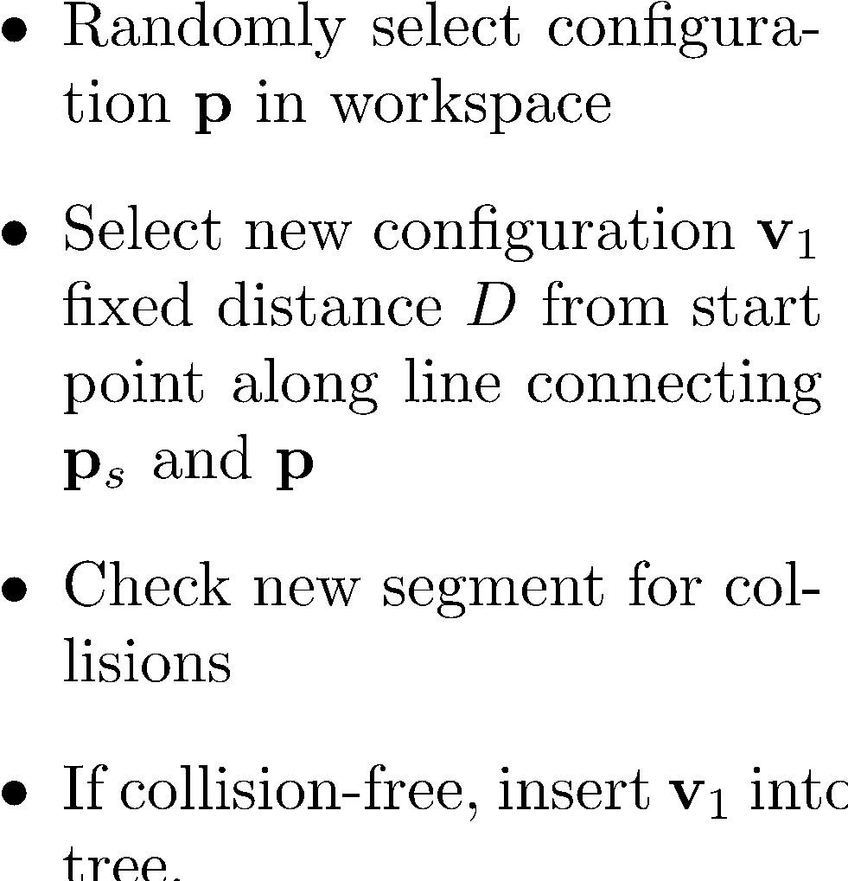

RRT Algorithm
Notes:
\begin{itemize}
\item Randomly select configuration $\mathbf{p}$ in workspace
\item Select new configuration $\mathbf{v}_1$ fixed distance $D$ from start point along line connecting $\mathbf{p}_s$ and $\mathbf{p}$
\item Check new segment for collisions
\item If collision-free, insert $\mathbf{v}_1$ into tree.
\end{itemize}

Slide 20
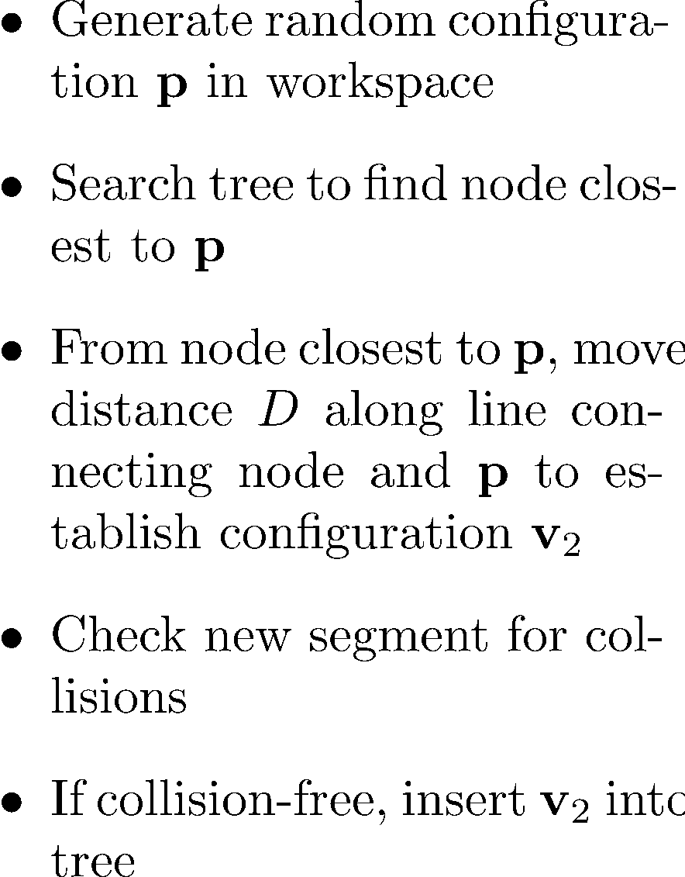
RRT Algorithm
Notes:
\begin{itemize}
\item Generate random configuration $\mathbf{p}$ in workspace
\item Search tree to find node closest to $\mathbf{p}$
\item From node closest to $\mathbf{p}$, move distance $D$ along line connecting node and $\mathbf{p}$ to establish configuration $\mathbf{v}_2$
\item Check new segment for collisions
\item If collision-free, insert $\mathbf{v}_2$ into tree
\end{itemize}

Slide 21
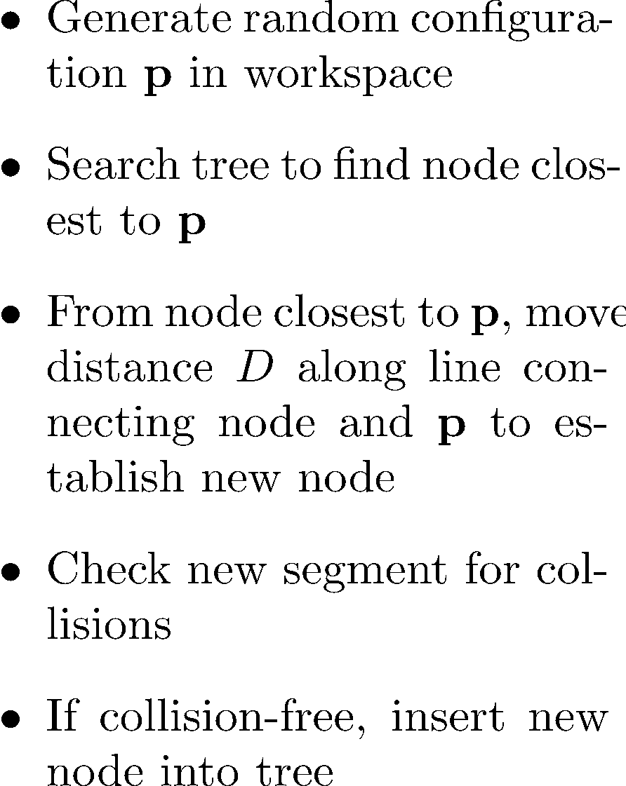

RRT Algorithm
Notes:
\begin{itemize}
\item Generate random configuration $\mathbf{p}$ in workspace
\item Search tree to find node closest to $\mathbf{p}$
\item From node closest to $\mathbf{p}$, move distance $D$ along line connecting node and $\mathbf{p}$ to establish new node
\item Check new segment for collisions
\item If collision-free, insert new node into tree
\end{itemize}

Slide 22
RRT Algorithm
Continue adding nodes and checking for collisions

Slide 23
RRT Algorithm
Continue until node is generated that is within distance D of end node
At this point, terminate algorithm or search for additional feasible paths

Slide 24
RRT Algorithm

Slide 25
Path Smoothing
Start with initial point (1)
Make connections to subsequent points in path (2), (3), (4) …
When connection collides with obstacle, add previous waypoint to smoothed path
Continue smoothing from this point to end of path

Slide 26
Path Smoothing Algorithm

Slide 27
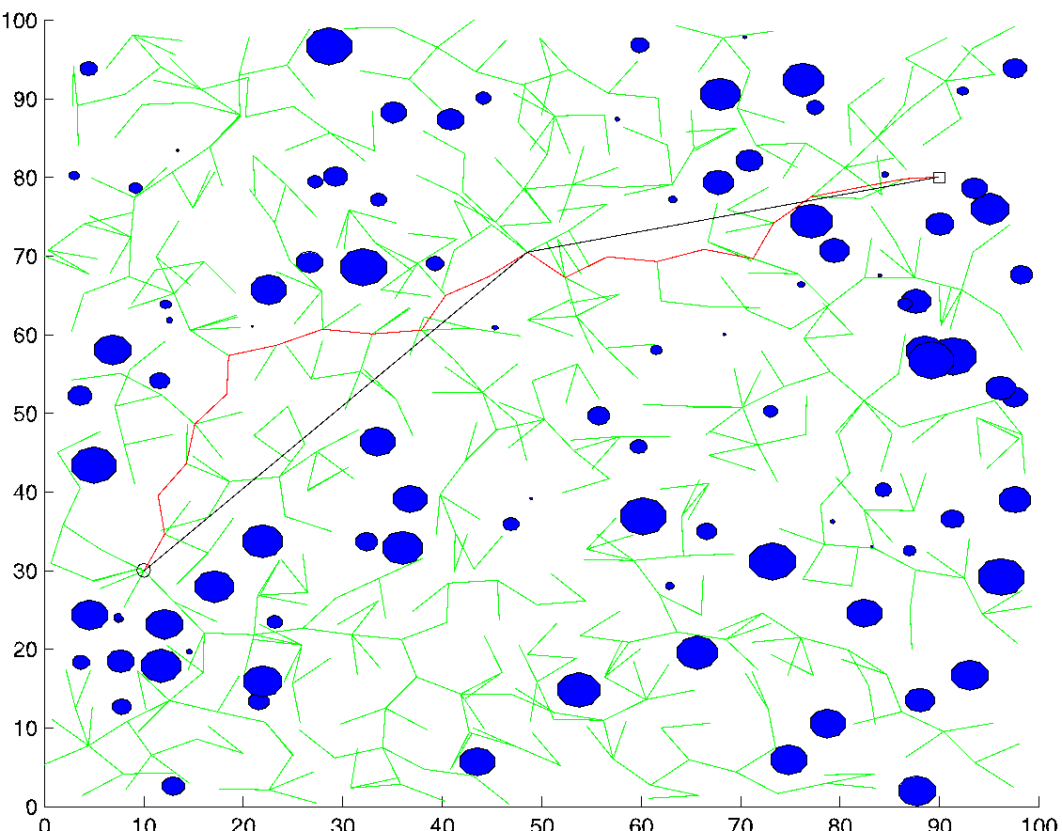
RRT Results

Slide 28
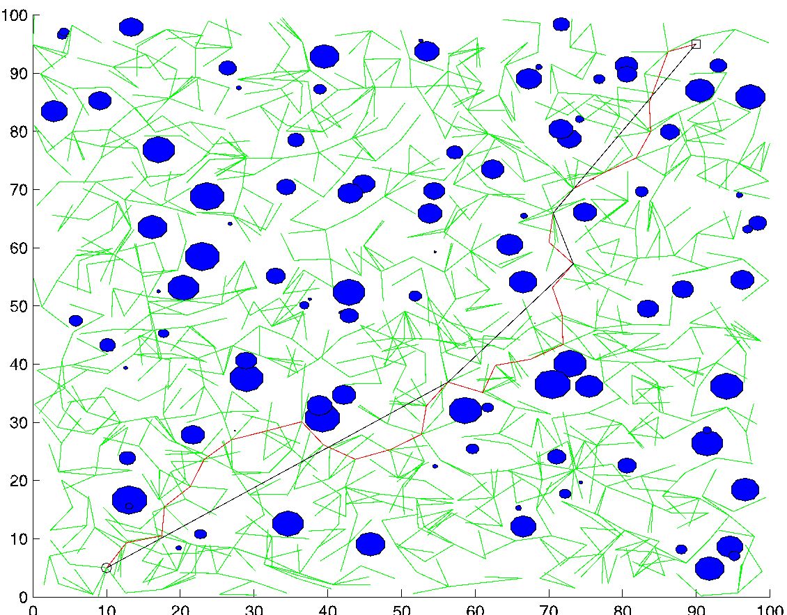
RRT Results

Slide 29
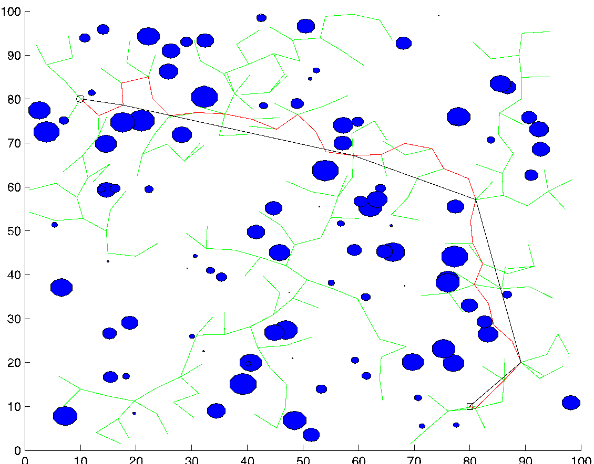
RRT Results

Slide 30
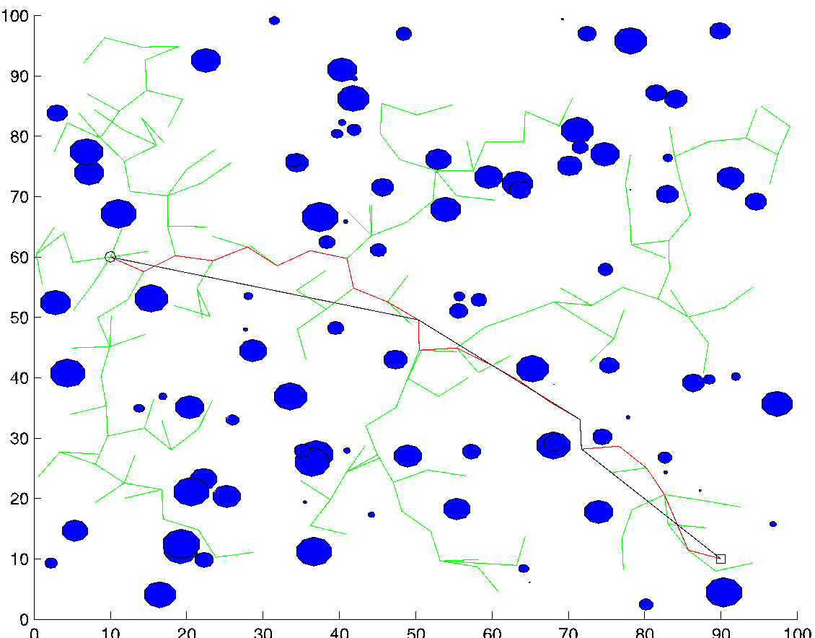
RRT Results

Slide 31
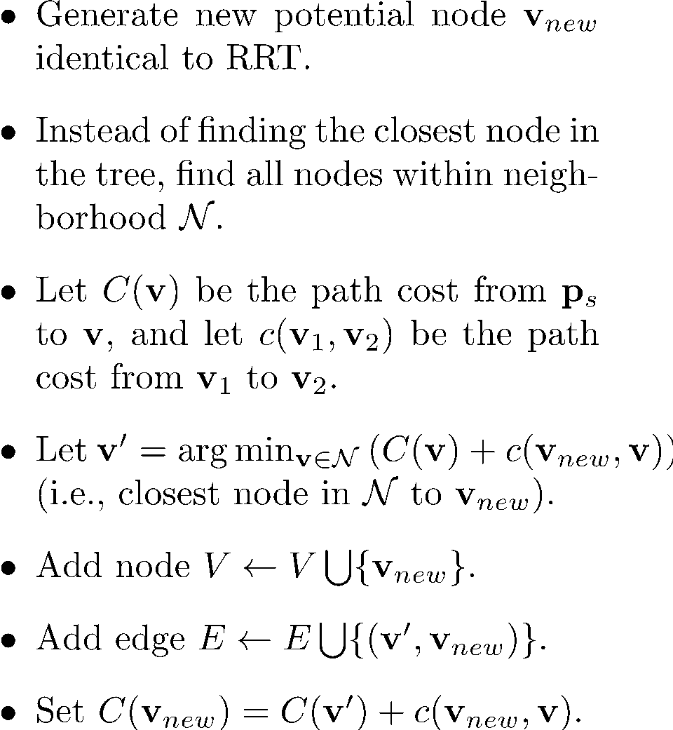



RRT* Algorithm – Extend Step
Notes:
\begin{itemize}
\item Generate new potential node $\mathbf{v}_{new}$ identical to RRT.
\item Instead of finding the closest node in the tree, find all nodes within neighborhood $\mathcal{N}$.
\item Let $C(\mathbf{v})$ be the path cost from $\mathbf{p}_s$ to $\mathbf{v}$, and let $c(\mathbf{v}_1,\mathbf{v}_2)$ be the path cost from $\mathbf{v}_1$ to $\mathbf{v}_2$.
\item Let $\mathbf{v}' = \arg\min_{\mathbf{v}\in \mathcal{N}}\left(C(\mathbf{v}) + c(\mathbf{v}_{new}, \mathbf{v})\right)$ (i.e., closest node in $\mathcal{N}$ to $\mathbf{v}_{new}$).
\item Add node $V\leftarrow V \bigcup \{\mathbf{v}_{new}\}$.
\item Add edge $E\leftarrow E\bigcup\{(\mathbf{v}',\mathbf{v}_{new})\}$.
\item Set $C(\mathbf{v}_{new}) = C(\mathbf{v}') + c(\mathbf{v}_{new}, \mathbf{v})$.
\end{itemize}

Slide 32
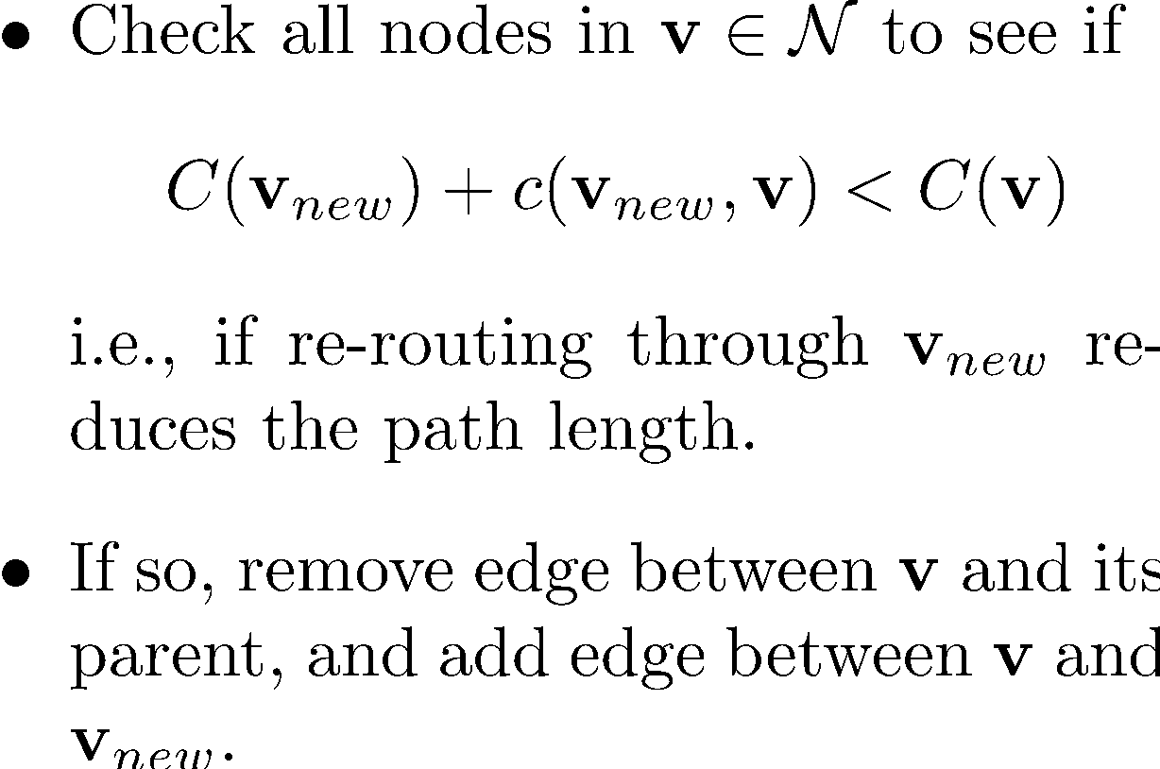
RRT* Algorithm – Re-wire Step
Notes:
\begin{itemize}
\item Generate new potential node $\mathbf{v}_{new}$ identical to RRT.
\item Instead of finding the closest node in the tree, find all nodes within neighborhood $\mathcal{N}$.
\item Let $C(\mathbf{v})$ be the path cost from $\mathbf{p}_s$ to $\mathbf{v}$, and let $c(\mathbf{v}_1,\mathbf{v}_2)$ be the path cost from $\mathbf{v}_1$ to $\mathbf{v}_2$.
\item Let $\mathbf{v}' = \arg\min_{\mathbf{v}\in \mathcal{N}}\left(C(\mathbf{v}) + c(\mathbf{v}_{new}, \mathbf{v})\right)$ (i.e., closest node in $\mathcal{N}$ to $\mathbf{v}_{new}$).
\item Add node $V\leftarrow V \bigcup \{\mathbf{v}_{new}\}$.
\item Add edge $E\leftarrow E\bigcup\{(\mathbf{v}',\mathbf{v}_{new})\}$.
\item Set $C(\mathbf{v}_{new}) = C(\mathbf{v}') + c(\mathbf{v}_{new}, \mathbf{v})$.
\end{itemize}

Slide 33
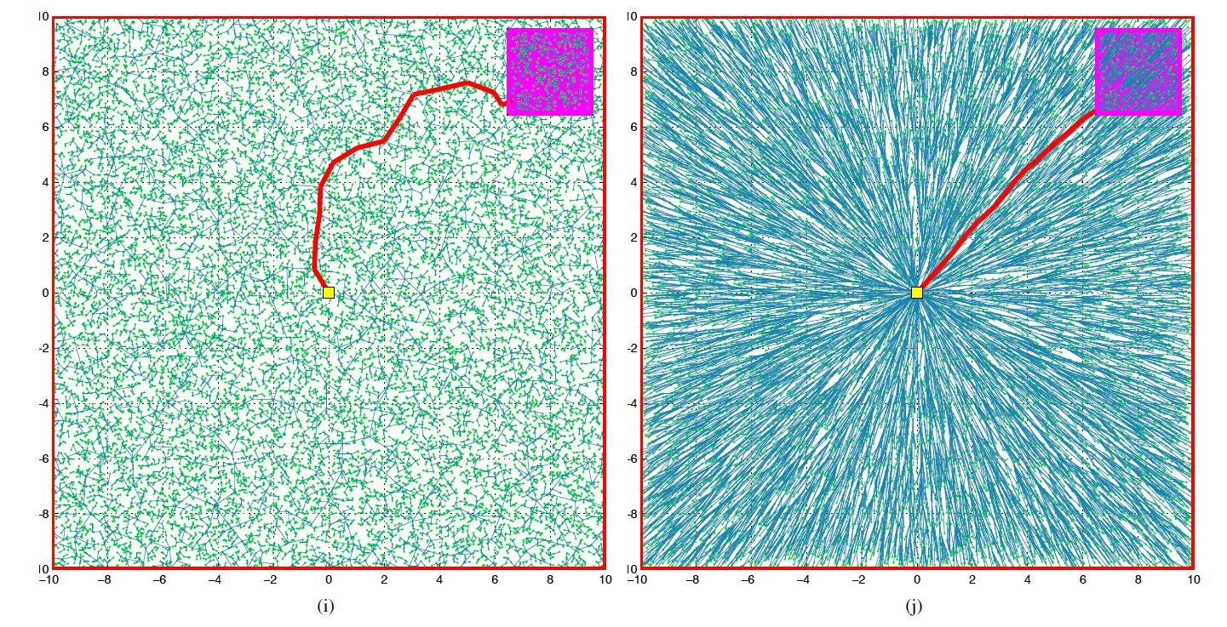
RRT vs. RRT*
From S. Karaman and E. Frazzoli, “Incremental Sampling-based Algorithms for
Optimal Motion Planning,” International Journal of Robotic Research, 2010.

Slide 34
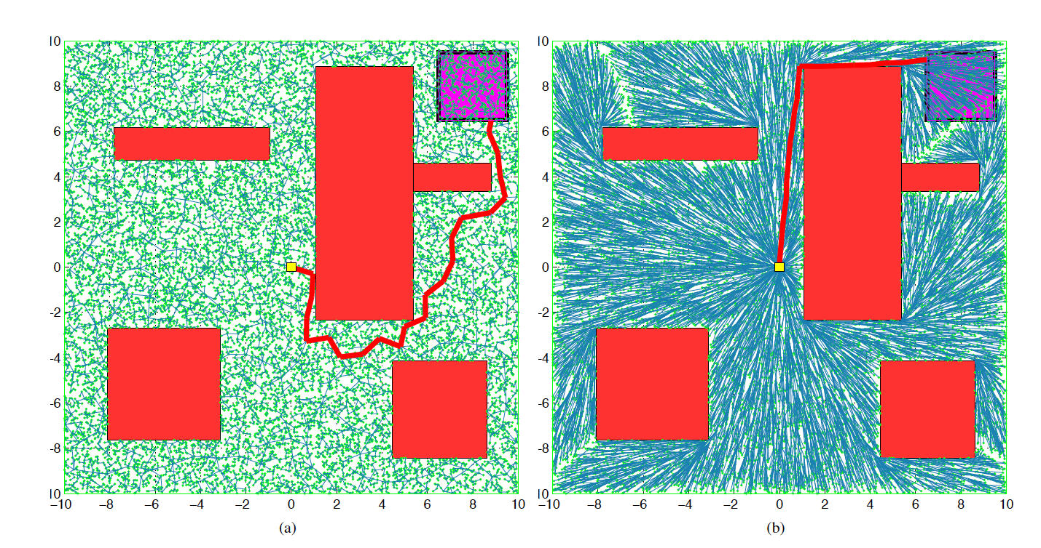
RRT vs. RRT*
From S. Karaman and E. Frazzoli, “Incremental Sampling-based Algorithms for
Optimal Motion Planning,” International Journal of Robotic Research, 2010.

Slide 35
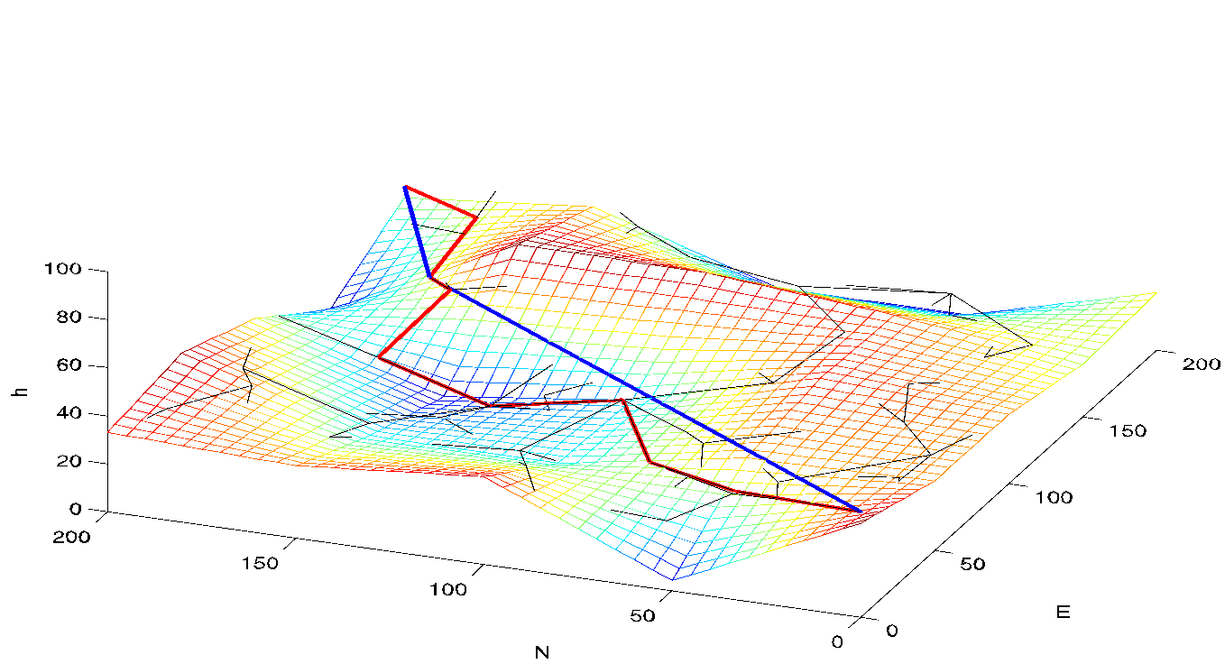
RRT Path Planning Over 3D Terrain
Assume terrain map can be queried to determine altitude of terrain at any north-east location
Must be able to determine altitude for random configuration p in RRT algorithm
Must be able to detect collisions with terrain – reject random candidate paths leading to collision
Options:
random altitude within predetermined range
random selection of discrete altitudes in desired range
set altitude above ground level
Test candidate paths to ensure flight path angles are feasible – reject if infeasible

Slide 36
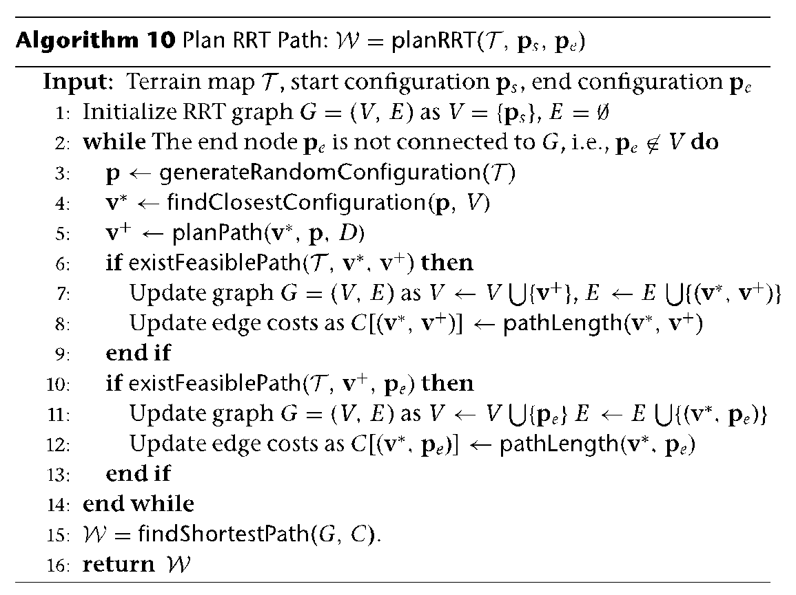
RRT Algorithm – 3D Terrain
modify to test for collisions
with terrain and flight path
angle feasibility

Slide 37
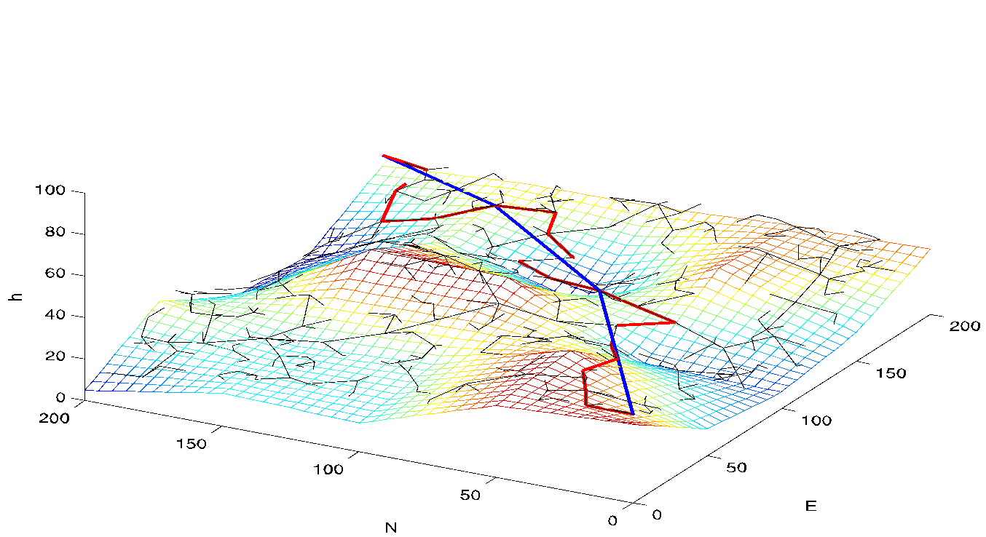
RRT 3D Terrain Results

Slide 38
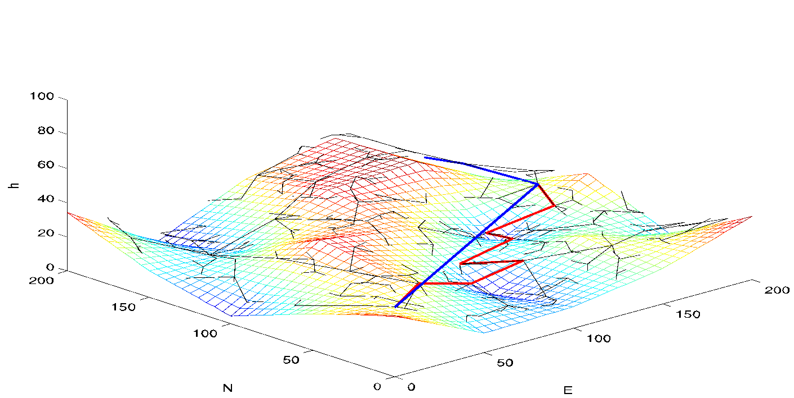
RRT 3D Terrain Results

Slide 39
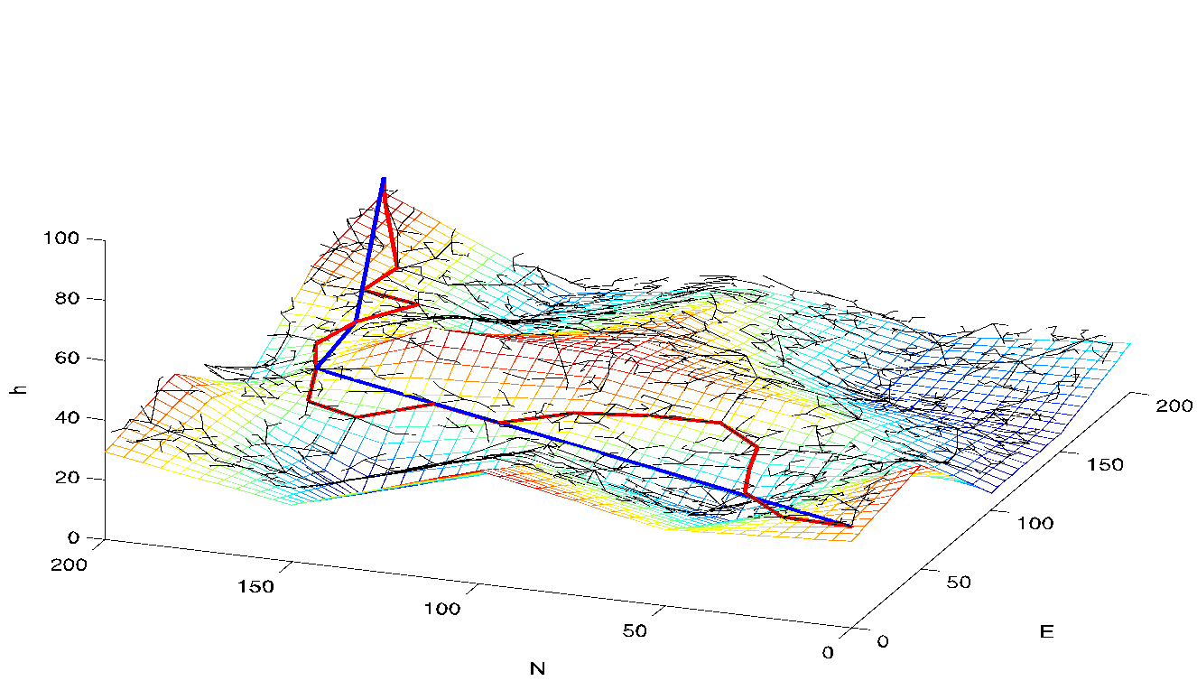
RRT 3D Terrain Results

Slide 40
RRT Dubins Approach
To generate a new random configuration for tree:
Generate random N-E position in environment
Find closest node in RRT graph to new random point
Select a position of distance L from the closest RRT node in direction of new point – use this position as N-E coordinates of new configuration
Define course angle for new configuration as the angle of the line connecting the RRT graph to the new configuration

Slide 41
RRT Algorithm - Dubins
Notes:
\begin{itemize}
\item Randomly select configuration $\mathbf{p}$ in workspace
\item Select new configuration $\mathbf{v}_1$ fixed distance $D$ from start point along line connecting $\mathbf{p}_s$ and $\mathbf{p}$
\item Check new segment for collisions
\item If collision-free, insert $\mathbf{v}_1$ into tree.
\end{itemize}

Slide 42
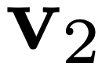
RRT Algorithm - Dubins
Notes:
\begin{itemize}
\item Randomly select configuration $\mathbf{p}$ in workspace
\item Select new configuration $\mathbf{v}_1$ fixed distance $D$ from start point along line connecting $\mathbf{p}_s$ and $\mathbf{p}$
\item Check new segment for collisions
\item If collision-free, insert $\mathbf{v}_1$ into tree.
\end{itemize}

Slide 43
RRT Algorithm - Dubins
Collision
Notes:
\begin{itemize}
\item Randomly select configuration $\mathbf{p}$ in workspace
\item Select new configuration $\mathbf{v}_1$ fixed distance $D$ from start point along line connecting $\mathbf{p}_s$ and $\mathbf{p}$
\item Check new segment for collisions
\item If collision-free, insert $\mathbf{v}_1$ into tree.
\end{itemize}

Slide 44
RRT Algorithm - Dubins
Continue adding nodes and checking for collisions
Notes:
\begin{itemize}
\item Randomly select configuration $\mathbf{p}$ in workspace
\item Select new configuration $\mathbf{v}_1$ fixed distance $D$ from start point along line connecting $\mathbf{p}_s$ and $\mathbf{p}$
\item Check new segment for collisions
\item If collision-free, insert $\mathbf{v}_1$ into tree.
\end{itemize}

Slide 45
RRT Algorithm
Continue until node is generated that is within distance D of end node
At this point, terminate algorithm or search for additional feasible paths

Slide 46
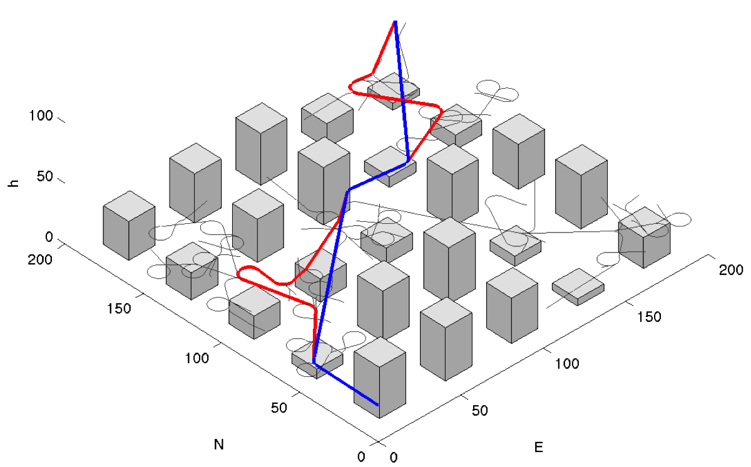
RRT Dubins Results

Slide 47
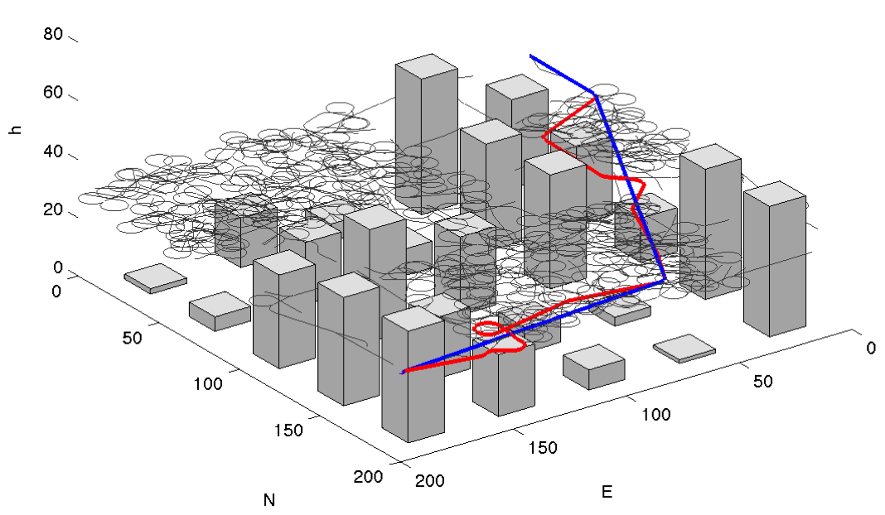
RRT Dubins Results

Slide 48
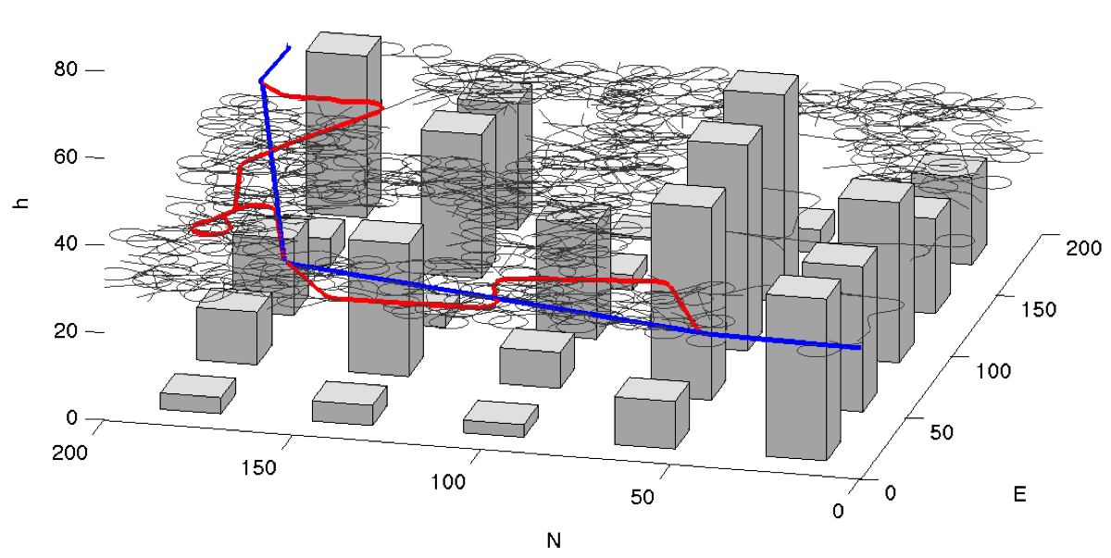
RRT Dubins Results

Slide 49
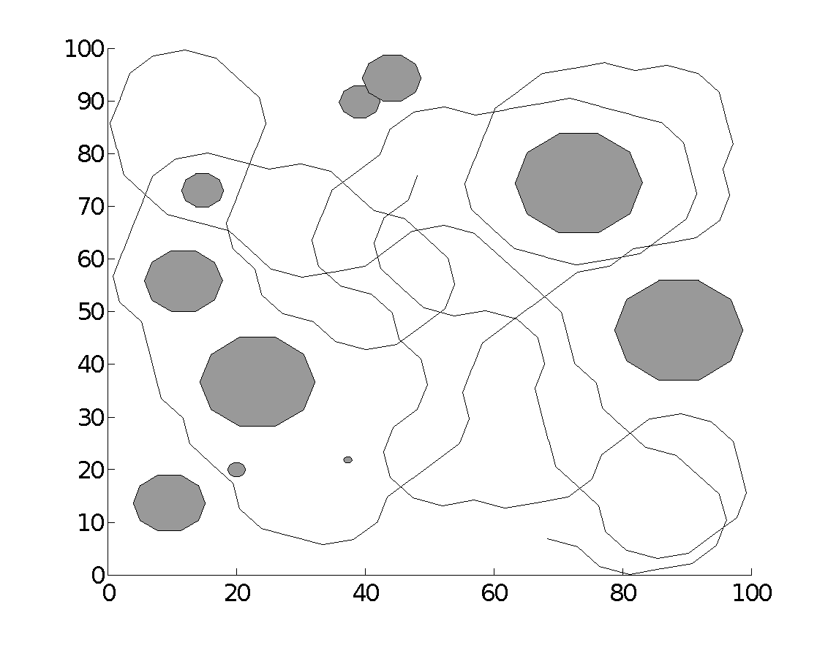
Coverage Algorithms
Goal: Survey an area
Pass sensor footprint over entire area
Algorithms often cell based
Goal: visit every cell

Slide 50
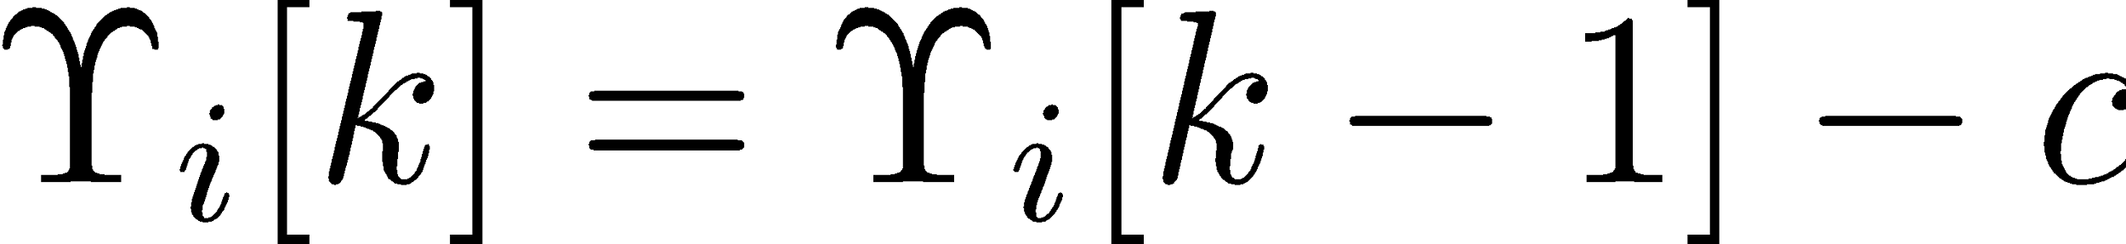
Coverage Algorithm
Two maps in memory
terrain map
used to detect collisions with environment
coverage or return map
used to track coverage of terrain
Return map stores value of returning to particular location
Return map initialized so that all locations have same return value
As locations are visited, return value of that location is decremented by fixed amount:

Slide 51
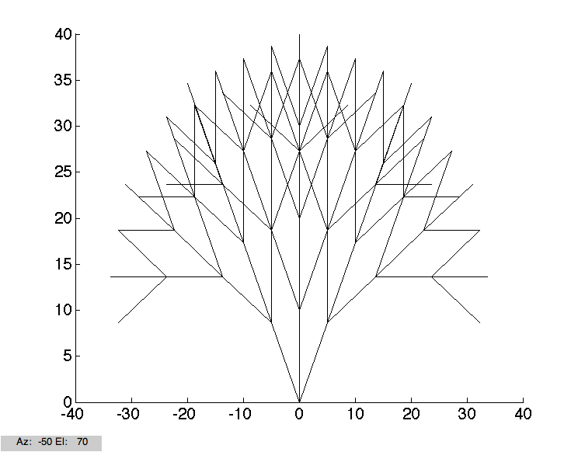
Coverage Algorithm
Finite look ahead tree search used to determine where to go
Tree generated from current MAV configuration
Tree searched to determine path that maximizes return value
Two methods for look ahead tree
Uniform branching
Predetermined depth
Uniform branch length
Uniform branch separation
RRT

Slide 52
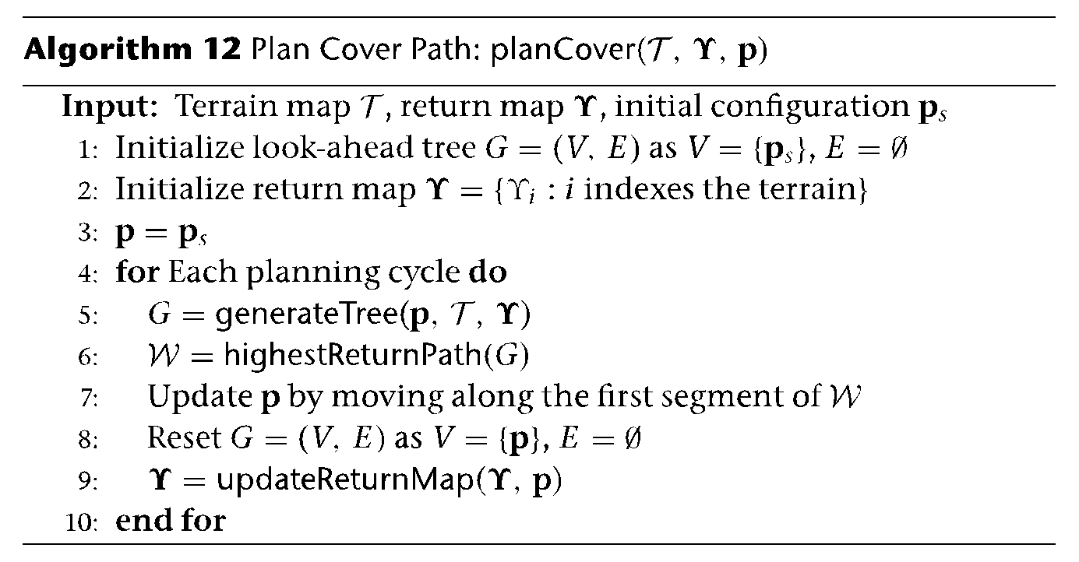
Coverage Algorithm

Slide 53
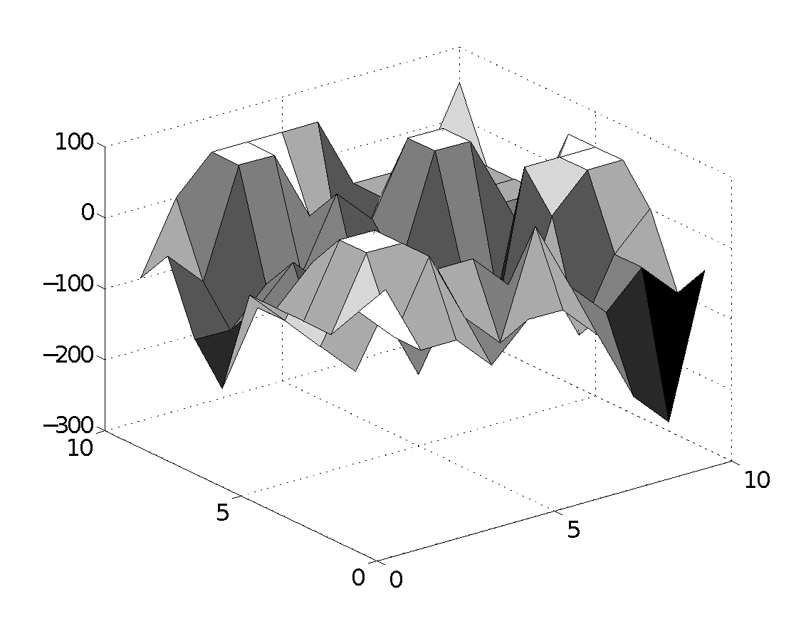
Coverage Planning Results – Uniform Tree
Look ahead length = 5
Heading change = 30 deg
Tree depth = 3
Iterations = 200

Slide 54
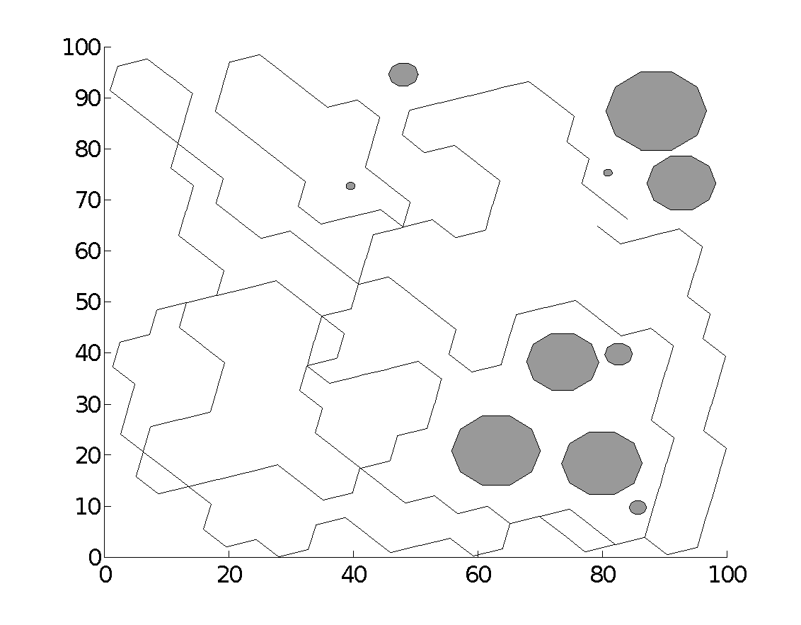
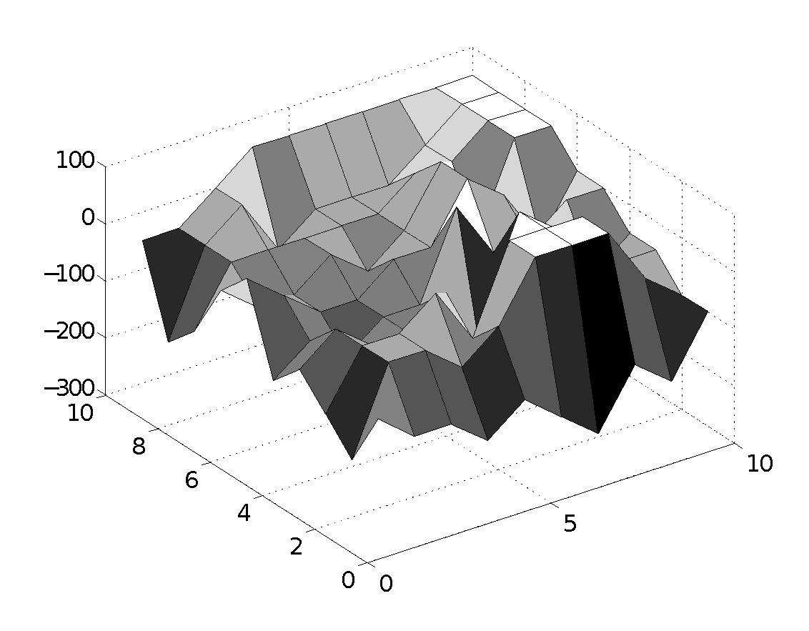
Coverage Planning Results – Uniform Tree
Look ahead length = 5
Heading change = 60 deg
Tree depth = 3
Iterations = 200

Slide 55
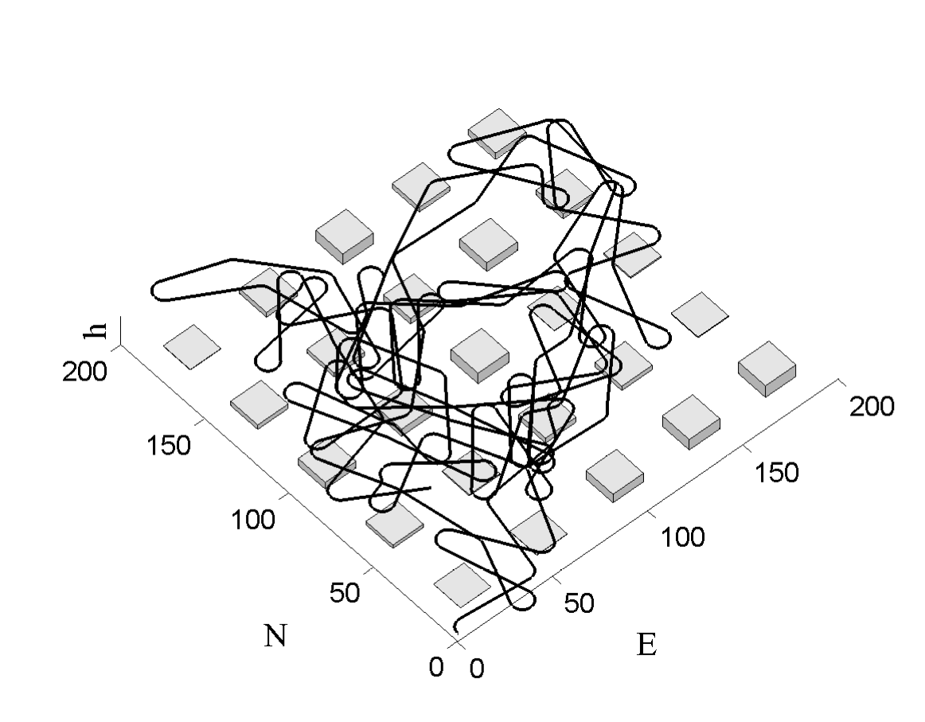
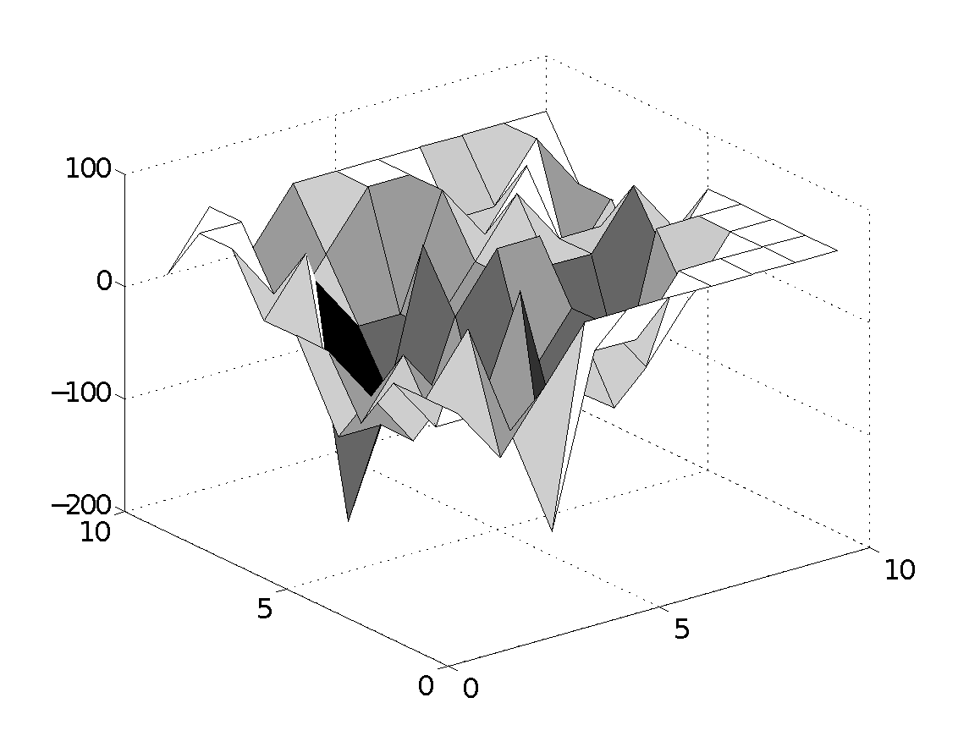
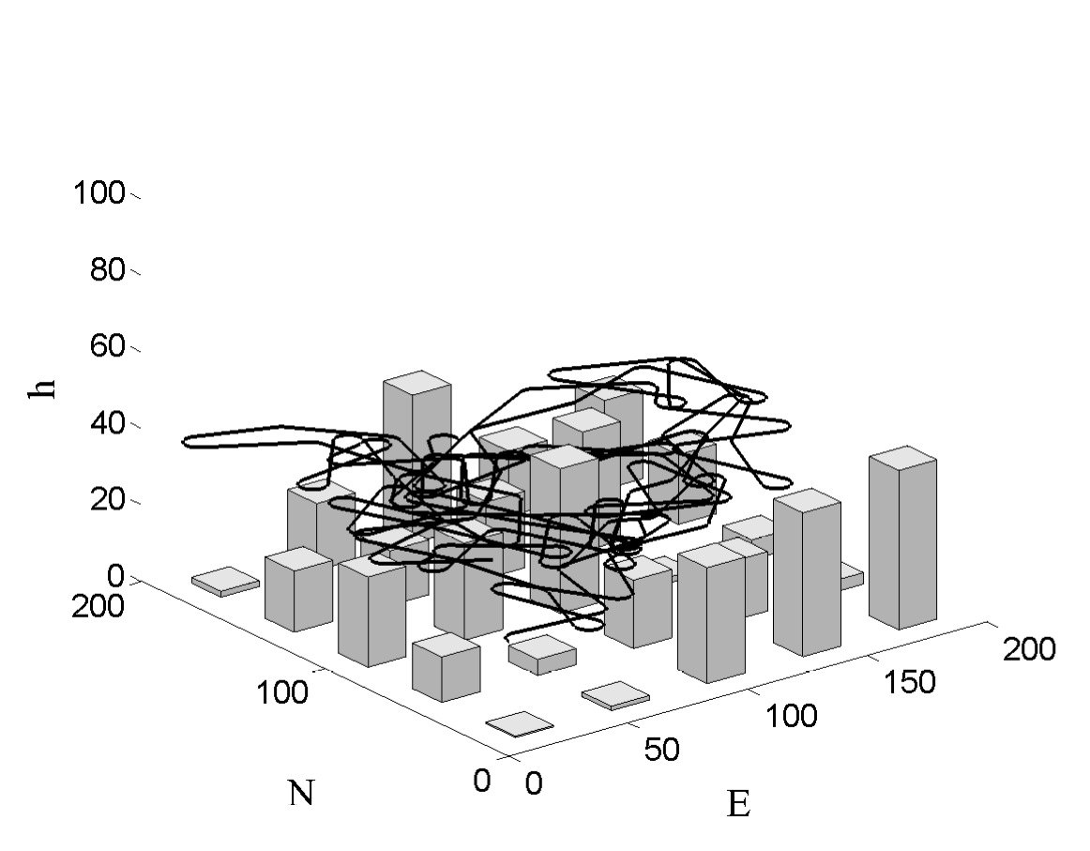
Coverage Planning Results – RRT Dubins

Slide 56
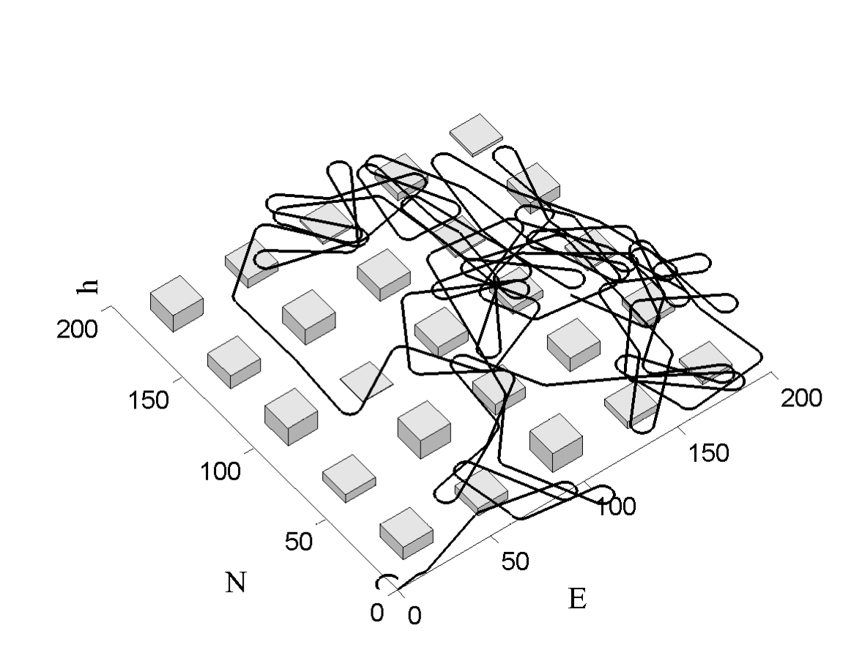
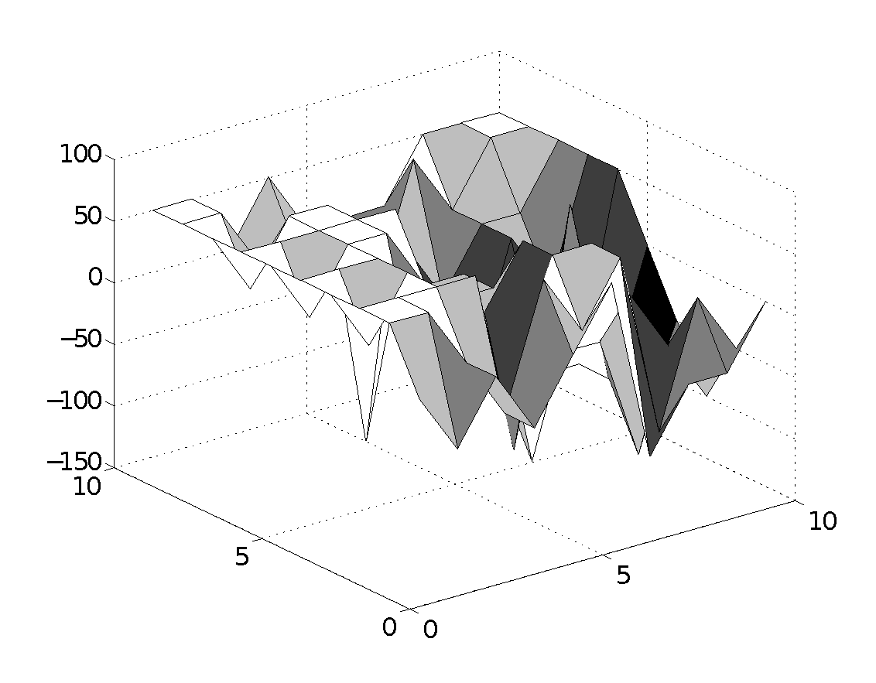
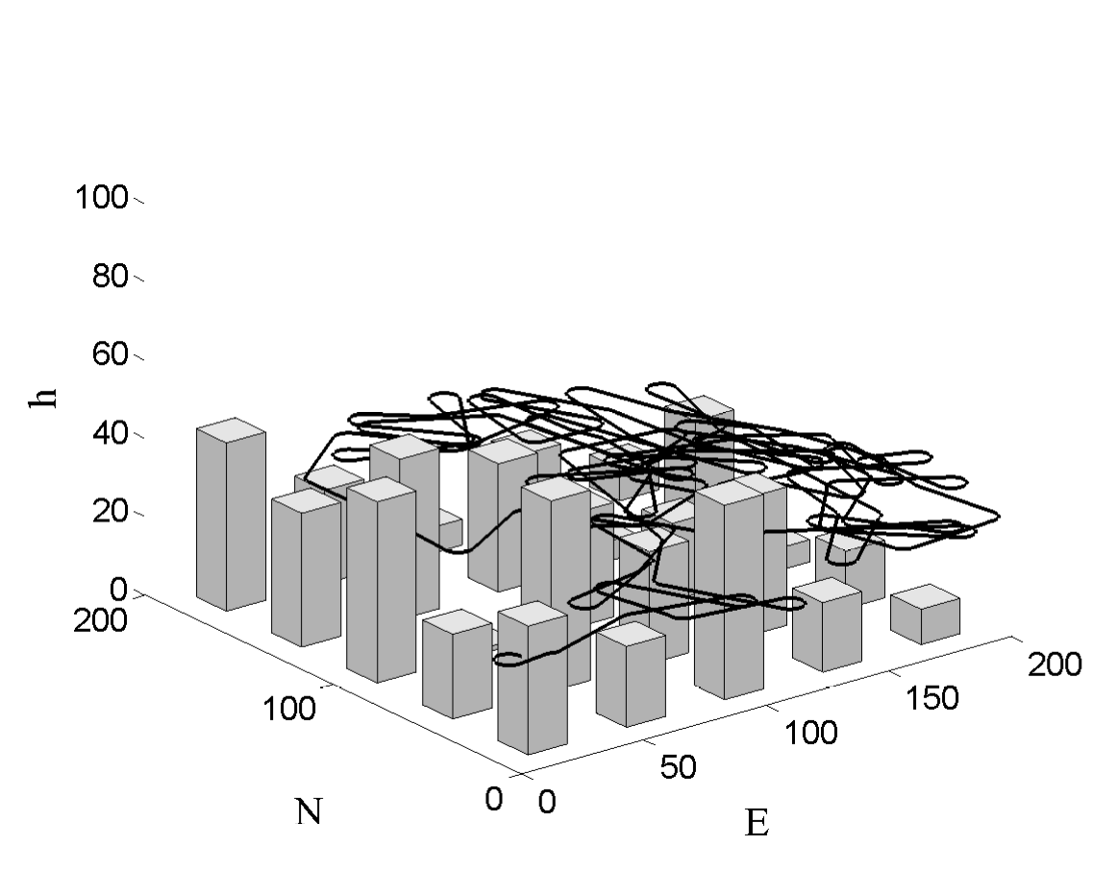
Coverage Planning Results – RRT Dubins

